Slide 1
Learning Objectives
Understand Turing's life and his three major contributions (the Turing machine, the idea of machine intelligence, and the Turing test). Comprehend the basic principles of the Turing machine and its foundational significance for modern computers. Grasp the design logic of the Turing test and its guiding value for artificial intelligence, and be able to explain the significance of the Turing test and its status in the field of AI. Appreciate Turing's scientific spirit and historical contributions, and cultivate a sense of reverence for scientific exploration.

Slide 2
Table of Contents
1. A Young Genius
2. Contribution One: The Turing Machine
3. The Young Cryptographer
4. Contribution Two: Initial Thoughts and Practices on Machine Intelligence
5. Contribution Three: The Turing Test
6. A Century of Influence

Slide 3

Introduction
What would life be like today without computers? Who laid the foundation for the birth of the computer?

Slide 4


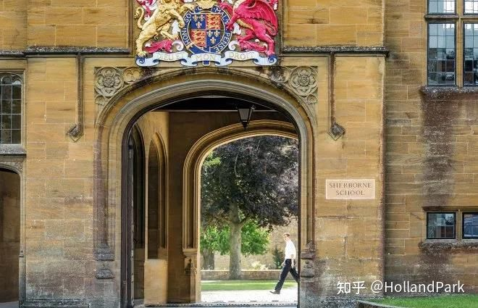
A Young Genius
Alan Turing, a great British mathematician and computer scientist, was a pioneer of computer science and the father of artificial intelligence.
Born on June 23, 1912, in London, England. While he was in primary school, his teacher wrote: 'I have met many bright and hardworking children, but Alan is a genius.'
In 1926, Turing entered Sherborne School in London, showing a great interest in science. At the age of 16, Turing encountered the work of Albert Einstein. It is said that Turing could not only understand these papers but had also deduced Einstein's critique of Newton's laws of motion.
Turing's Hometown - Paddington, London, UK
Turing at 16
Sherborne School, London

Slide 5
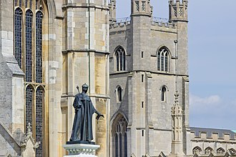
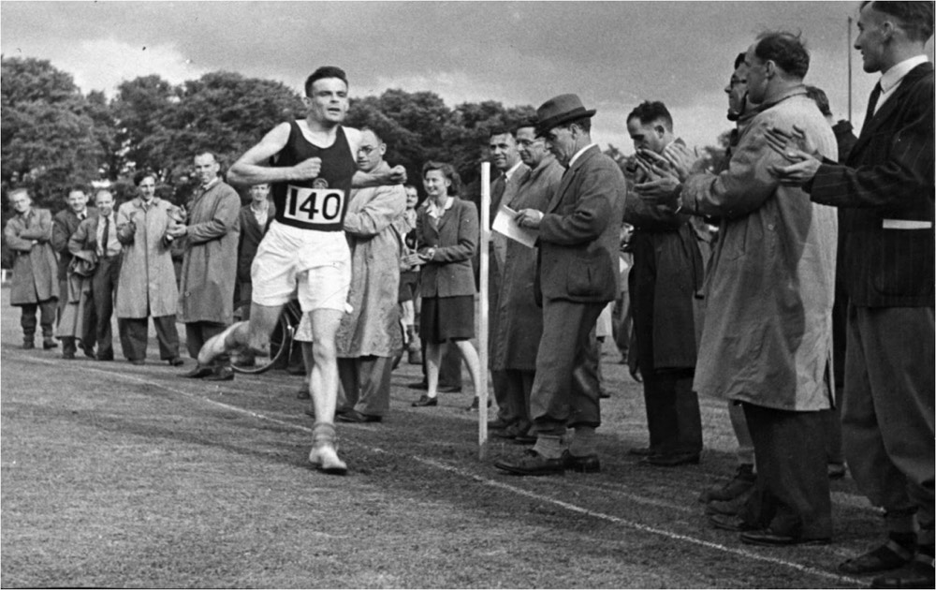
Showing Early Promise
In 1931, Turing was admitted to the University of Cambridge. He was awarded a mathematics scholarship for his outstanding academic performance. At Cambridge, his mathematical abilities were fully developed.
In 1935, his first mathematical paper, 'Equivalence of Left and Right Almost Periodicity,' was published in the Journal of the London Mathematical Society. In the same year, he also wrote a paper 'On the Gaussian Error Function.' This paper led to his election as a Fellow of King's College directly from being an undergraduate. The following year, he was awarded the prestigious Smith's Prize, becoming one of King's College's most distinguished graduates.
King's College, University of Cambridge
Turing was also an accomplished long-distance runner

Slide 6
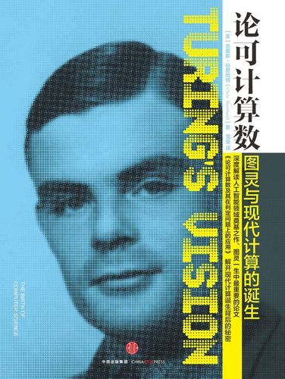
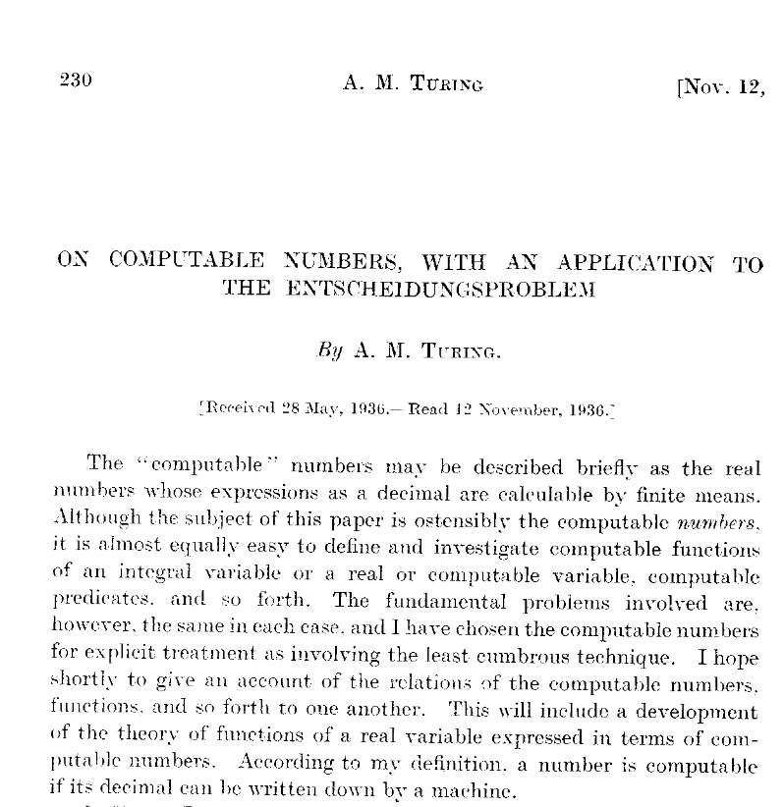
Contribution One: The Turing Machine
The Innovation and Significance of the Turing Machine Model
In 1936, at the age of just 24, Turing published a groundbreaking paper, 'On Computable Numbers, with an Application to the Entscheidungsproblem.' The purpose of this paper was to disprove a 'decision problem' (Entscheidungsproblem) proposed by Hilbert, which asked whether a universal algorithm exists that can determine if any given problem is solvable.
To illustrate this problem, Turing proposed a universal computational model, later known as the 'Turing machine,' which laid the theoretical foundation for the birth of modern computers. Because of this great contribution, Turing is known as the father of computer science.
Notes:
在《列子·汤问》中还记载了一个同时代的巧匠，名叫偃师。偃师比鲁班和墨子还要厉害，可以用木头、毛发、油漆等材料制造出惟妙惟肖的人偶，从外表看和真人无异，而且能歌善舞。偃师带着这个人偶去见周穆王，让它为大家献歌献舞。歌舞很成功，观众陶醉于其中。只是歌舞结束的时候出了差错，人偶向穆王的姬人们“暗送秋波”，惹得穆王大怒，要将偃师和这个人偶一并处死。偃师慌忙解释，并亲自动手把人偶剖开，果然是一堆零件。穆王这才相信这个人偶确实不是真人，赦免了偃师。鲁班和墨子听说这个故事后大为震撼，从此再也不敢自认为手艺高超了。这个故事当然只是个传说，2000多年前是不可能造出如此惟妙惟肖的人偶来的。尽管如此，这个故事充分体现了古人对智能机器的向往。

Slide 7
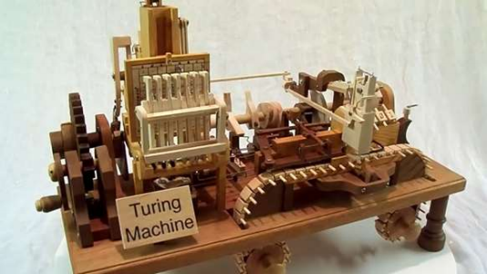
Contribution One: The Turing Machine
The Turing Machine's Contribution to Computer Science and Artificial Intelligence
The proposal of the Turing machine directly inspired confidence in designing general-purpose computers.
Its concepts, such as a memory store, program, and controller, provided inspiration for the stored-program architecture designed by von Neumann and others, thus laying the foundation for modern computer architecture. From an AI perspective, computation is the cornerstone of artificial intelligence. Without the birth of the computer, there would be no beginning for AI. Therefore, the proposal of the Turing machine provided the computational tools for the development of AI, making it key to AI's birth and growth.
Notes:
在《列子·汤问》中还记载了一个同时代的巧匠，名叫偃师。偃师比鲁班和墨子还要厉害，可以用木头、毛发、油漆等材料制造出惟妙惟肖的人偶，从外表看和真人无异，而且能歌善舞。偃师带着这个人偶去见周穆王，让它为大家献歌献舞。歌舞很成功，观众陶醉于其中。只是歌舞结束的时候出了差错，人偶向穆王的姬人们“暗送秋波”，惹得穆王大怒，要将偃师和这个人偶一并处死。偃师慌忙解释，并亲自动手把人偶剖开，果然是一堆零件。穆王这才相信这个人偶确实不是真人，赦免了偃师。鲁班和墨子听说这个故事后大为震撼，从此再也不敢自认为手艺高超了。这个故事当然只是个传说，2000多年前是不可能造出如此惟妙惟肖的人偶来的。尽管如此，这个故事充分体现了古人对智能机器的向往。

Slide 8
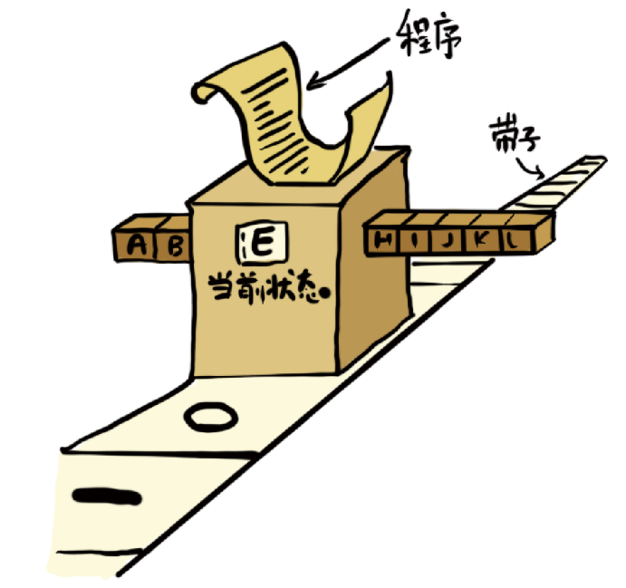
Contribution One: The Turing Machine
A Turing machine is a mathematical model of computation, or a hypothetical machine. This machine consists of an infinitely long tape, a read-write head, a state register, and a set of operating rules, i.e., a program.
The machine changes its register state based on the current state and the symbol read from the tape, and the program generates actions, including moving the read-write head and rewriting data onto the tape.
Notes:
在《列子·汤问》中还记载了一个同时代的巧匠，名叫偃师。偃师比鲁班和墨子还要厉害，可以用木头、毛发、油漆等材料制造出惟妙惟肖的人偶，从外表看和真人无异，而且能歌善舞。偃师带着这个人偶去见周穆王，让它为大家献歌献舞。歌舞很成功，观众陶醉于其中。只是歌舞结束的时候出了差错，人偶向穆王的姬人们“暗送秋波”，惹得穆王大怒，要将偃师和这个人偶一并处死。偃师慌忙解释，并亲自动手把人偶剖开，果然是一堆零件。穆王这才相信这个人偶确实不是真人，赦免了偃师。鲁班和墨子听说这个故事后大为震撼，从此再也不敢自认为手艺高超了。这个故事当然只是个传说，2000多年前是不可能造出如此惟妙惟肖的人偶来的。尽管如此，这个故事充分体现了古人对智能机器的向往。

Slide 9

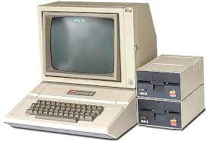
Contribution One: The Turing Machine
Turing and subsequent researchers discovered that such a simple machine is incredibly powerful, and many seemingly powerful computational models are equivalent to the Turing machine. Therefore, Church, Turing, and Gödel proposed the famous Church-Turing thesis: Every intuitively computable function can be computed by a Turing machine.
This conclusion became the beginning of computability theory, laying the theoretical foundation for the emergence of general-purpose computers. Most of the smart devices we use today are based on this fundamental principle proposed by Turing.
Notes:
在《列子·汤问》中还记载了一个同时代的巧匠，名叫偃师。偃师比鲁班和墨子还要厉害，可以用木头、毛发、油漆等材料制造出惟妙惟肖的人偶，从外表看和真人无异，而且能歌善舞。偃师带着这个人偶去见周穆王，让它为大家献歌献舞。歌舞很成功，观众陶醉于其中。只是歌舞结束的时候出了差错，人偶向穆王的姬人们“暗送秋波”，惹得穆王大怒，要将偃师和这个人偶一并处死。偃师慌忙解释，并亲自动手把人偶剖开，果然是一堆零件。穆王这才相信这个人偶确实不是真人，赦免了偃师。鲁班和墨子听说这个故事后大为震撼，从此再也不敢自认为手艺高超了。这个故事当然只是个传说，2000多年前是不可能造出如此惟妙惟肖的人偶来的。尽管如此，这个故事充分体现了古人对智能机器的向往。

Slide 11
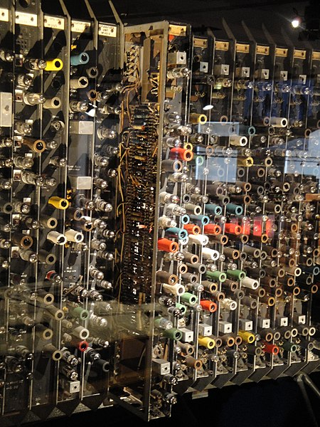
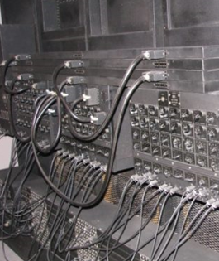
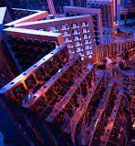
Contribution One: The Turing Machine
Without the birth of the computer, there would be no beginning for artificial intelligence. From this perspective, Turing was the one who prepared the tools for AI.
The ACE computer, which Turing personally participated in developing
The early general-purpose electronic computer, ENIAC
USTC's quantum computer, Jiuzhang
Notes:
在《列子·汤问》中还记载了一个同时代的巧匠，名叫偃师。偃师比鲁班和墨子还要厉害，可以用木头、毛发、油漆等材料制造出惟妙惟肖的人偶，从外表看和真人无异，而且能歌善舞。偃师带着这个人偶去见周穆王，让它为大家献歌献舞。歌舞很成功，观众陶醉于其中。只是歌舞结束的时候出了差错，人偶向穆王的姬人们“暗送秋波”，惹得穆王大怒，要将偃师和这个人偶一并处死。偃师慌忙解释，并亲自动手把人偶剖开，果然是一堆零件。穆王这才相信这个人偶确实不是真人，赦免了偃师。鲁班和墨子听说这个故事后大为震撼，从此再也不敢自认为手艺高超了。这个故事当然只是个传说，2000多年前是不可能造出如此惟妙惟肖的人偶来的。尽管如此，这个故事充分体现了古人对智能机器的向往。

Slide 12
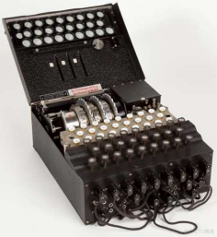
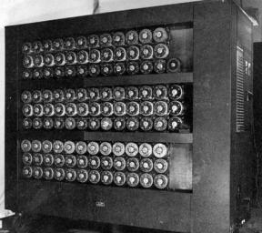
The Young Cryptographer
Turing's Cryptographic Contributions in World War II
Shortly after returning to his country, Turing joined a government code-breaking project, working with top mathematicians from across the country to decipher German codes at Bletchley Park in Buckinghamshire.
Turing cracked the enhanced Enigma machine and developed a set of highly efficient algorithms. It is estimated that Turing's work shortened the war by two years, saving over 14 million lives.

Slide 13
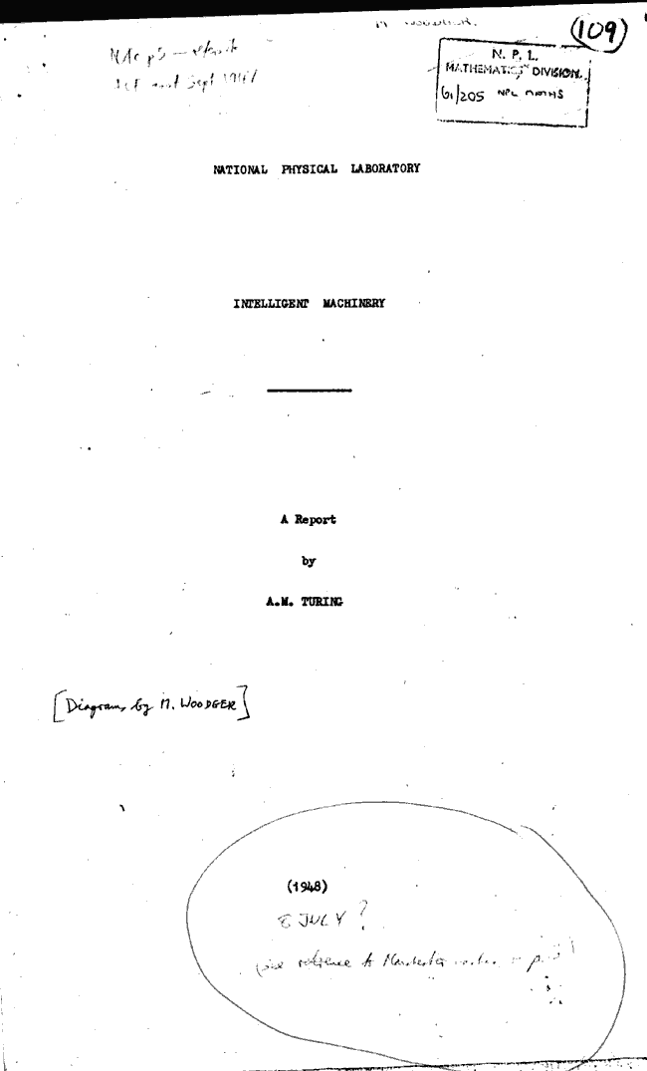

Contribution Two: Initial Thoughts and Practices on Machine Intelligence
In 1948, Turing became a lecturer at the University of Manchester; in 1951, he was elected a Fellow of the Royal Society.
In 1948, Turing published a report titled 'Intelligent Machinery,' proposing the possibility of achieving intelligence with machines and exploring several implementation methods. This report became the clarion call for artificial intelligence to enter the historical stage.
Notes:
图片来自 Lewis的 “The Silent Reader”（1920）。

Slide 14
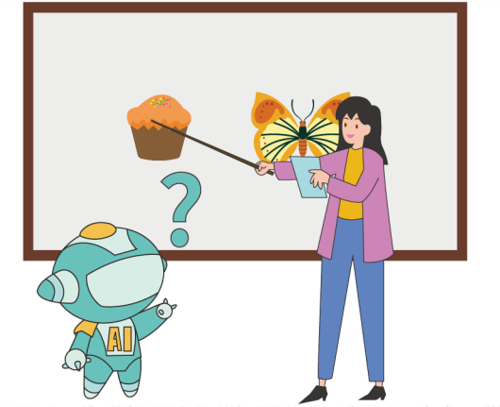





Contribution Two: Initial Thoughts and Practices on Machine Intelligence
He believed a universal machine could be designed and taught to grow step-by-step, like teaching a child. This is the naive idea of machine learning.
He also proposed that machines could be 'educated' through rewards and punishments, which is the basic idea of reinforcement learning.
奖励信号：拿对了就有骨头吃
苹果 ！
苹果 ！
奖励信号：拿错了就不给骨头吃
Notes:
图片来自 Lewis的 “The Silent Reader”（1920）。

Slide 15
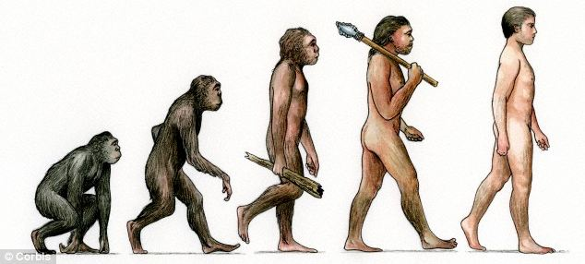
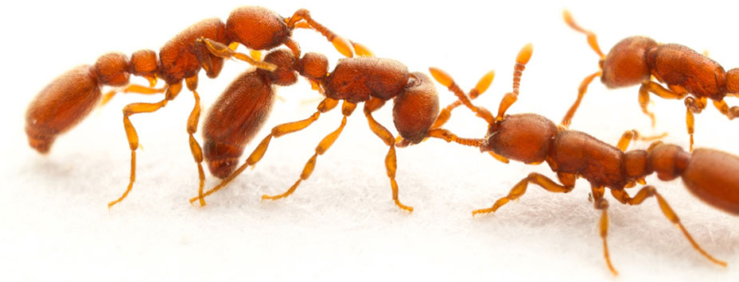
Contribution Two: Initial Thoughts and Practices on Machine Intelligence
He even proposed methods for achieving intelligence by simulating biological evolution and group activities, which became the initial seed of the idea of evolutionary learning.
Biological evolution is the result of natural selection, including human evolution. Biological evolution plays an important role in the emergence of intelligence. Turing believed that imitating this process was a possible way to make machines intelligent.
Many animals possess a certain level of intelligence. For example, a colony of ants engages in group activities, collaboratively completing tasks that individuals cannot. Birds, bees, and apes exhibit similar behaviors. Simulating these group behaviors is an effective learning method.
Notes:
图片来自 Lewis的 “The Silent Reader”（1920）。

Slide 16
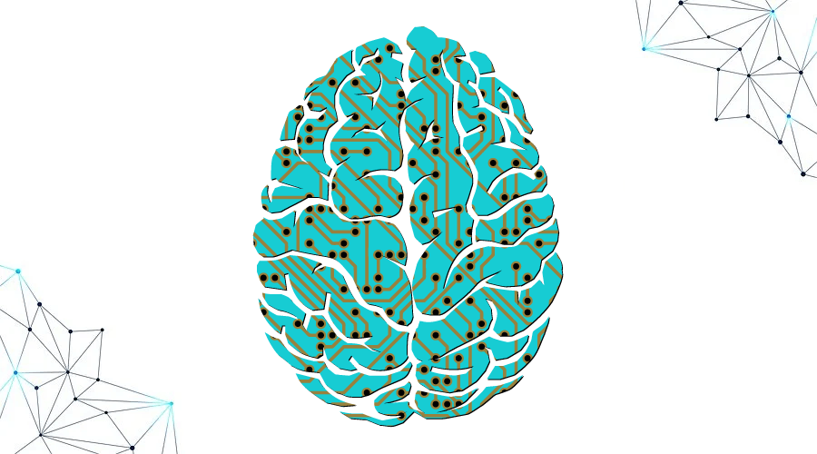
Contribution Two: Initial Thoughts and Practices on Machine Intelligence
Turing's genius ideas were the first intellectual treasure at the dawn of AI development, and they continue to guide future generations today. From this perspective, Turing was the one who laid the ideological foundation for artificial intelligence.
Notes:
图片来自 Lewis的 “The Silent Reader”（1920）。

Slide 17
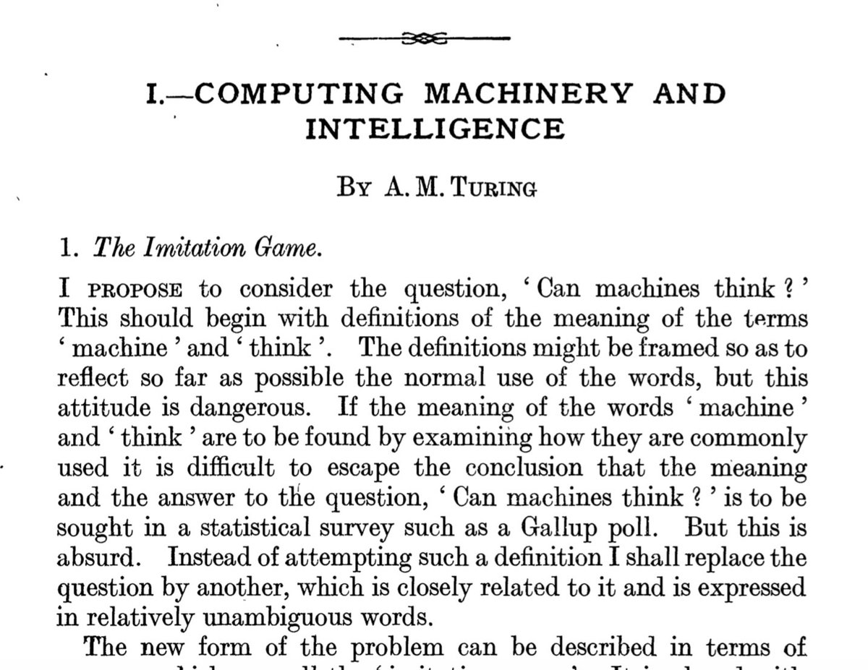
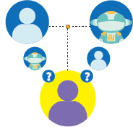
Contribution Three: The Turing Test
In 1950, Turing published the paper 'Computing Machinery and Intelligence.' This article proposed a thought experiment that later became known as the 'Turing test.'
Through this thought experiment, Turing defined intelligence in an experimental way: if we cannot distinguish a machine's behavior from a human's, then the machine is considered to possess intelligence.
The Turing Test: A human and a computer are placed in separate rooms. A human interrogator engages in a natural language conversation with both via a keyboard. After 5 minutes, if the machine can make over 30% of the interrogators mistake it for a human, it is considered to have intelligence.
Notes:
图片来自 Lewis的 “The Silent Reader”（1920）。

Slide 18
Notes:
小清爱提问《什么是图灵测试》。

Slide 19
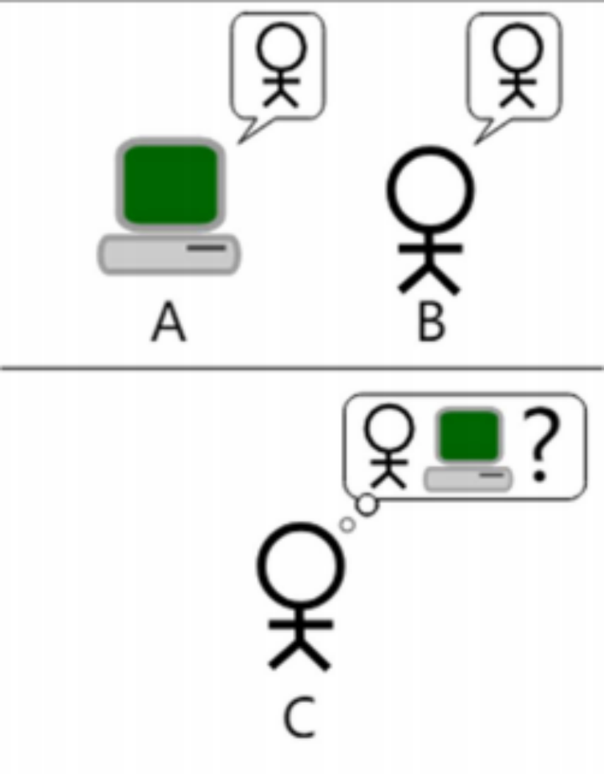
Contribution Three: The Turing Test
1. Interrogator: A human interrogator C. 2. Participants: A human B and a machine A. 3. Form of Dialogue: Interrogator C communicates with participants A/B via a keyboard in natural language. The interrogator does not know which is the human and which is the machine. 4. Test Duration: Typically set to 5 minutes. 5. Passing Criterion: If, after the test, the machine causes the interrogator to misidentify it as human with a probability of over 30%, then the machine is considered to have passed the Turing test and possess intelligence.
"
Contribution Three: The Turing Test
The great significance of the Turing test is that it provides a way to define intelligence, thereby freeing researchers from conceptual disputes over 'intelligence' and setting a direction for AI researchers to strive for. From this perspective, Turing was the one who designed the direction for artificial intelligence.
The Role of the Turing Test in the Development of Artificial Intelligence
Classroom Activities and Discussion

Slide 20
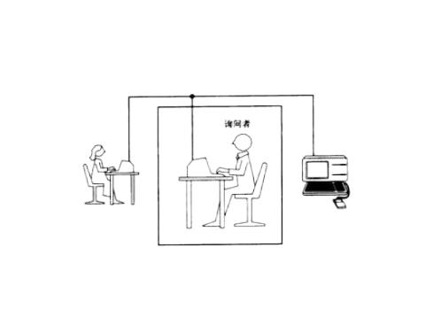
Activity 1: Turing Test Rules (Role-Playing Simulation)
Significance of the Test:
Students role-play as the interrogator, the human, and the AI, trying to determine 'who is human' through text-based conversation.

Slide 21
Bypasses philosophical debates by defining intelligence through 'behavioral performance' → Drives the development of AI technology.
Discussion of Limitations:
Case Study: Chatbots can pass the test but lack true understanding (e.g., GPT-3).
Classroom Activities and Discussion
Activity 2: Design a Simplified Turing Machine
Group Task:
Simulate a Turing machine calculating '1+1' using paper tape, markers, and instruction cards.

Slide 22
Discussion: 'How can the calculation be completed in a finite number of steps? What is the connection to modern computers?'
Classroom Activities and Discussion
Activity 3: Turing Test Debate
Debate Topic: Is the Turing test still the gold standard for judging machine intelligence?
Group Task:

Slide 23
Group A (Pro): List cases of modern AI passing the test (e.g., Google Duplex).
Group B (Con): Analyze the test's loopholes (e.g., lack of emotion, creativity).
24
On June 8, 1954, Turing died of cyanide poisoning at the age of 41. However, his contributions not only laid the cornerstone of computer science but also had a profound impact on the birth and development of artificial intelligence. The Turing machine model, the initial concepts of machine intelligence, and the Turing test, all proposed by Turing, have become classic theories and methods in the field of AI. Turing's ideas and contributions continue to influence the development of computer science and artificial intelligence to this day.
A Century of Influence
A Century of Influence

Slide 24
Notes:
小清爱提问《为什么说图灵是人工智能之父》，总结图灵的三个贡献。

Slide 25
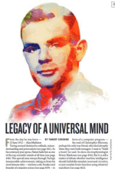
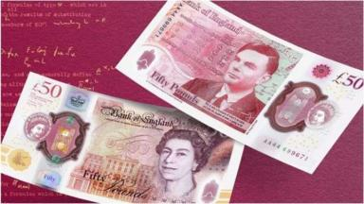
01
The Significance of Turing's Commemoration and Honors for the Development of AI

Slide 26
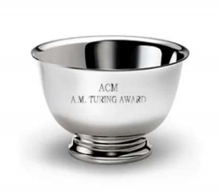
百年影响
01
图灵的纪念与荣誉对人工智能发展的意义
为了纪念图灵，全球计算机专业的权威组织——美国计算机协会（ACM）于1966年设立了图灵奖，用以表彰在计算机领域做出卓越贡献的学者。图灵奖被誉为计算机界的诺贝尔奖，自1966年到2023年，共有77位科学家获得此奖项。图灵的纪念和荣誉，不仅是对他个人贡献的肯定，也是对计算机科学和人工智能领域成就的肯定，激励着后来者继续在人工智能领域探索和前进。

